Slide 1
從年青人角度探討金融科技與電子消費的關係
FinTech
e
c
h
e-pay
Prof. Louis Cheng
S H Ho Professor of Banking & Finance
Hang Seng University
恒生大學 何善衡博士銀行及金融學教授
Master
Date: Mar 10, 2022
Time: 2:40-2:55pm
Place: A401
Animation: https://imechewebresources.blob.core.windows.net/imeche-web-content/images/default-source/default-album/shutterstock_597557036.jpg?sfvrsn=53c08d12_0
https://www.freeiconspng.com/img/44736

Slide 2
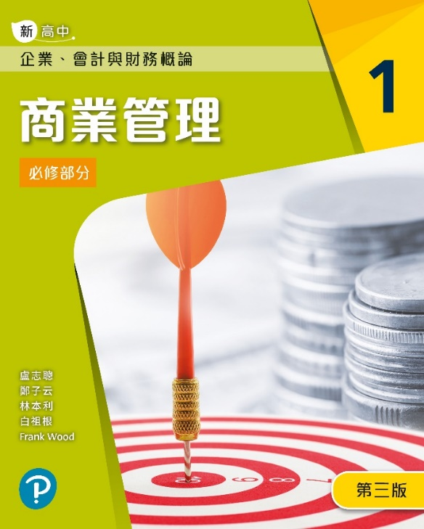
醫院管理局公積金計劃投資委員會成員(2016-現在)
聯合國融資顧問
律師紀律審裁團之成員(2013-19 年)
研究資助局商學小組(自資學位界別)
2011-13年期間擔任香港理工大學校董會成員及大學退休金信託人
香港財務策劃師學會(IFPHK)考試理事會成員，2001年 CFP^{CM}資格
為多間金融公司出任項目顧問:
証監會、積金局、香港交易所、投資者教育中心
中銀私人銀行、農行私人銀行、惠理基金管理公司(風險分析)、富邦銀行(財富管理)、銀聯信託、嘉信理財(美國)
鄭教授為兩本新高中企業、會計與財務概論課程教科書的作者，著作為培生出版的“基礎個人理財”及“財務管理”。鄭教授為
恒生大學 何善衡博士銀行及金融學教授及商學研究所主任。為醫管局公積金投資委員會成員，參與管理超過HK$680億港元(2020年3月)投資組合。

Slide 3
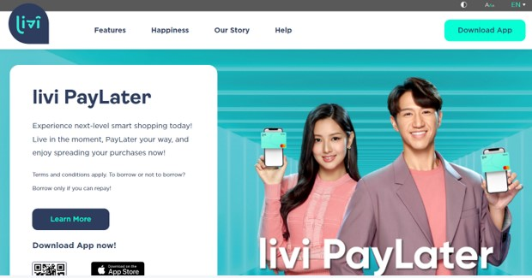
3

Slide 4
Hong Kong's digital banking begins with eight virtual banks (Sept 15, 2020)
Airstar Bank
by
Xiaomi, global IoT leader, and AMTD
Do you know?
Ant Bank
by
AlipayHK
Livi Bank
by
BOCHK, JD Digits ,and Jardines
Fusion Bank
by
Tencent, ICBC, HKEx, Hillhouse, and CEO of New World, Adrian Cheng ( Perfect Ridge)
Mox Bank
by
Standard Chartered, HKT, PCC, and Trip.com
PAO Bank
by
Ping An Insurance
WeLab Bank
by
Hutchison's TOM, IFC, Sequoia Capital, ING…
ZA Bank
by
ZhongAn Online P&C Insurance, and Sinolink
4

Slide 5
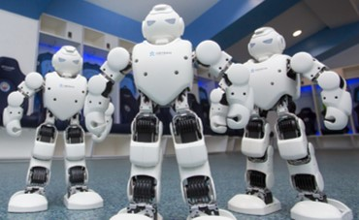
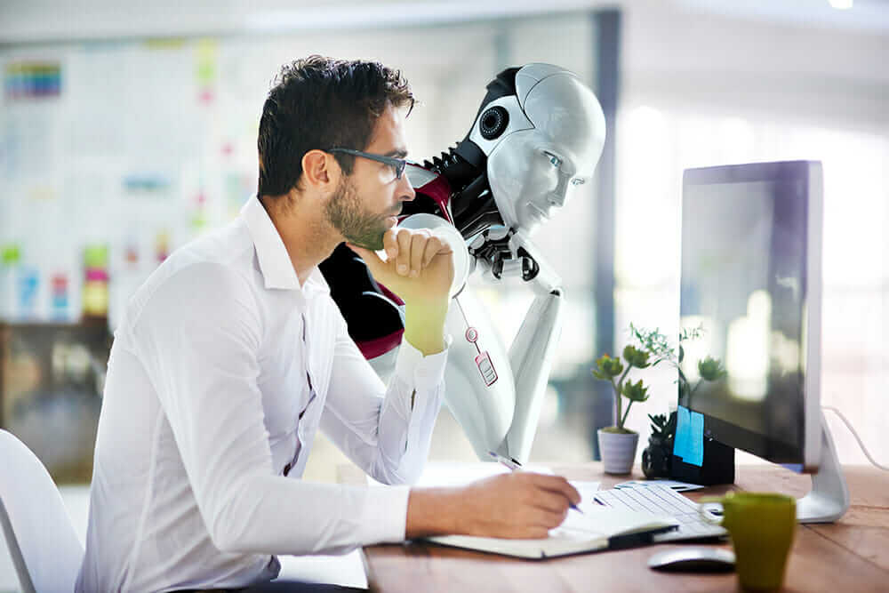
Fintech and Robo
Machine learning applied to finance is using artificial intelligence (AI) based on computer algorithm to make investment predictions by using BIG DATA.
Manchester City have partnered with a Chinese humanoid robotics firm, Ubtech Robotics, in a new sponsorship agreement
What is a robo-advisor?
A robo-advisor is an online, automated portfolio management service. Computer algorithms are used to choose appropriate investments based on risk tolerance and time horizon of clients. Robo-advisors offer services for a fraction of the cost of a human financial advisor.
Source: https://www.nerdwallet.com/blog/investing/best-robo-advisors/
https://www.google.com/url?sa=i&source=images&cd=&cad=rja&uact=8&ved=2ahUKEwixiKTH1I3gAhUPat4KHQzGCG4QjRx6BAgBEAU&url=https%3A%2F%2Fwww.thetimes.co.uk%2Farticle%2Frobots-to-take-30-of-graduates-work-auditor-warns-d69rtmqtj&psig=AOvVaw36QZK7rpqKamETlDzdjUSN&ust=1548668065863251
https://www.thedrum.com/news/2016/09/14/manchester-city-promise-reinvent-the-fan-experience-through-partnership-with

Slide 6
Disruptive innovation behind Fintech
Smartphone technologies
Cloud Computing
Big Data
Artificial Intelligence
Blockchain
Cybersecurity
~Thank You~
6

